Slide 1
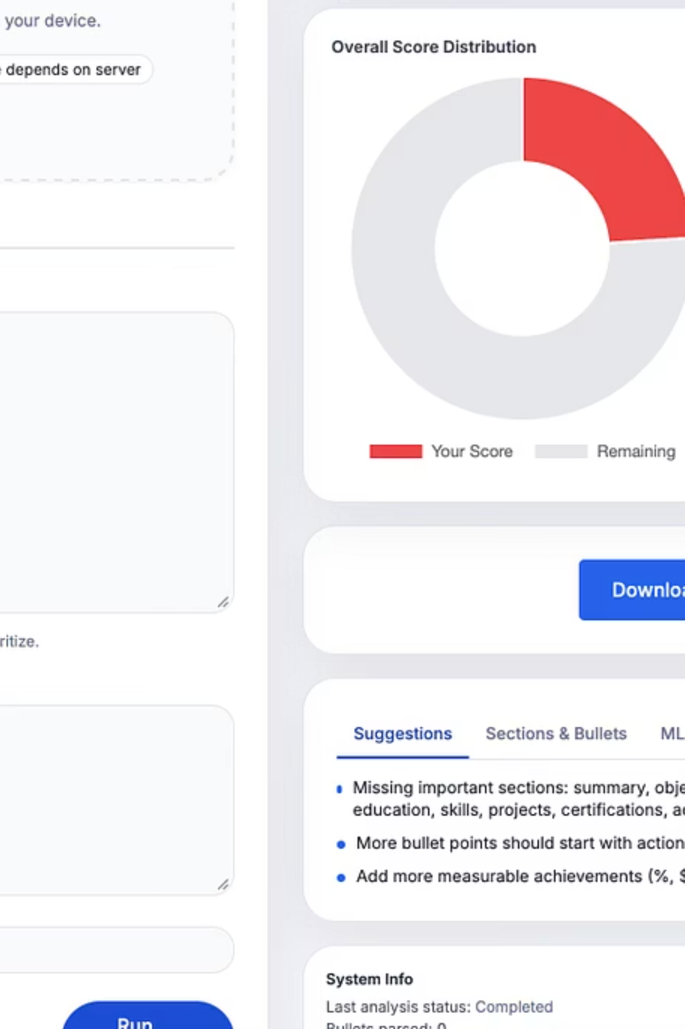
Resume Suggestion and Multi-Label Classification System Using Machine Learning
AI-Powered Resume Feedback and Classification System
Presented by: [Your Name]
Institution / Course: [Your Institution / Course]
Date: [Date]

Slide 2

Introduction: Revolutionising Resume Optimisation
Our system leverages advanced Machine Learning to provide comprehensive feedback on resumes. It's designed to streamline the job application process by offering intelligent, actionable insights.
Optimising resumes is crucial in today's competitive job market, where a well-crafted CV can significantly enhance a candidate's visibility and chances of securing an interview.
Existing resume review tools often fall short, providing generic advice or lacking the depth needed for true impact. They struggle with context and fail to offer structured, multi-faceted feedback.

Slide 3


Aim of the Project: Intelligent Analysis & Classification
The core aim of this project is to develop an AI-driven system that goes beyond basic resume checks. We focus on three key areas:
Intelligent Resume Analysis
Personalised Improvement Suggestions
To critically evaluate resume content for effectiveness and relevance, providing a deeper understanding of its strengths and weaknesses.
To generate tailor-made recommendations that address specific areas for enhancement, moving beyond one-size-fits-all advice.
Machine Learning Classification
To categorise these suggestions using advanced Machine Learning techniques, ensuring structured and easily digestible feedback.

Slide 4
Key Objectives: Achieving Precision & Automation
To deliver on our project's aim, we have set forth several critical objectives:
Automate Resume Evaluation
Develop a system capable of automatically assessing resumes for quality and completeness, reducing manual effort and human bias.
Detect Key Resume Elements
Accurately identify missing sections, weak phrases, impactful metrics, and industry-specific keywords crucial for optimal resume performance.
Generate Human-Readable Suggestions
Ensure that all feedback is clear, concise, and easy for users to understand and implement, facilitating effective resume refinement.
Multi-Label ML Classification
Employ Machine Learning to assign multiple relevant labels to each suggestion, enhancing the organisation and utility of the feedback.
Produce Structured Output
Design the system to generate output that is easily consumable by UI and API integrations, enabling seamless application development.

Slide 5


System Study: Bridging the Feedback Gap
Limitations of Existing Tools
Current resume analysis tools often provide superficial feedback. They typically:
Lack contextual understanding of job roles.
Offer generic advice without specific examples.
Fail to categorise feedback effectively, making it hard to prioritise.
Are primarily rule-based, missing nuances only AI can detect.
Our system addresses these shortcomings by integrating intelligent, structured feedback. It aims to provide nuanced, actionable insights that are easily understood and applied by users, significantly improving the overall resume evaluation process.

Slide 6

System Analysis: Foundations for Success
Functional Requirements
Non-Functional Requirements
Resume parsing and extraction.
High accuracy in classification.
Rule-based content analysis.
Fast processing of resumes.
ML-driven suggestion classification.
Scalability for large user bases.
User-friendly interface.
Output generation for UI/API.
Robust data security and privacy.
User authentication and profile management.
Feasibility Study Summary
The project is deemed highly feasible, both technically and economically. The availability of open-source ML libraries and data processing tools significantly reduces development costs and accelerates implementation. Market demand for intelligent resume tools ensures strong potential for adoption.

Slide 7


System Architecture: A Unified Approach
Data Input
Analysis
Suggestion Generator
ML Classifier
Our system architecture is designed for modularity and scalability. Raw resume data enters the system, undergoes comprehensive analysis, and then flows through our suggestion generation and machine learning classification modules to produce actionable output.

Slide 8
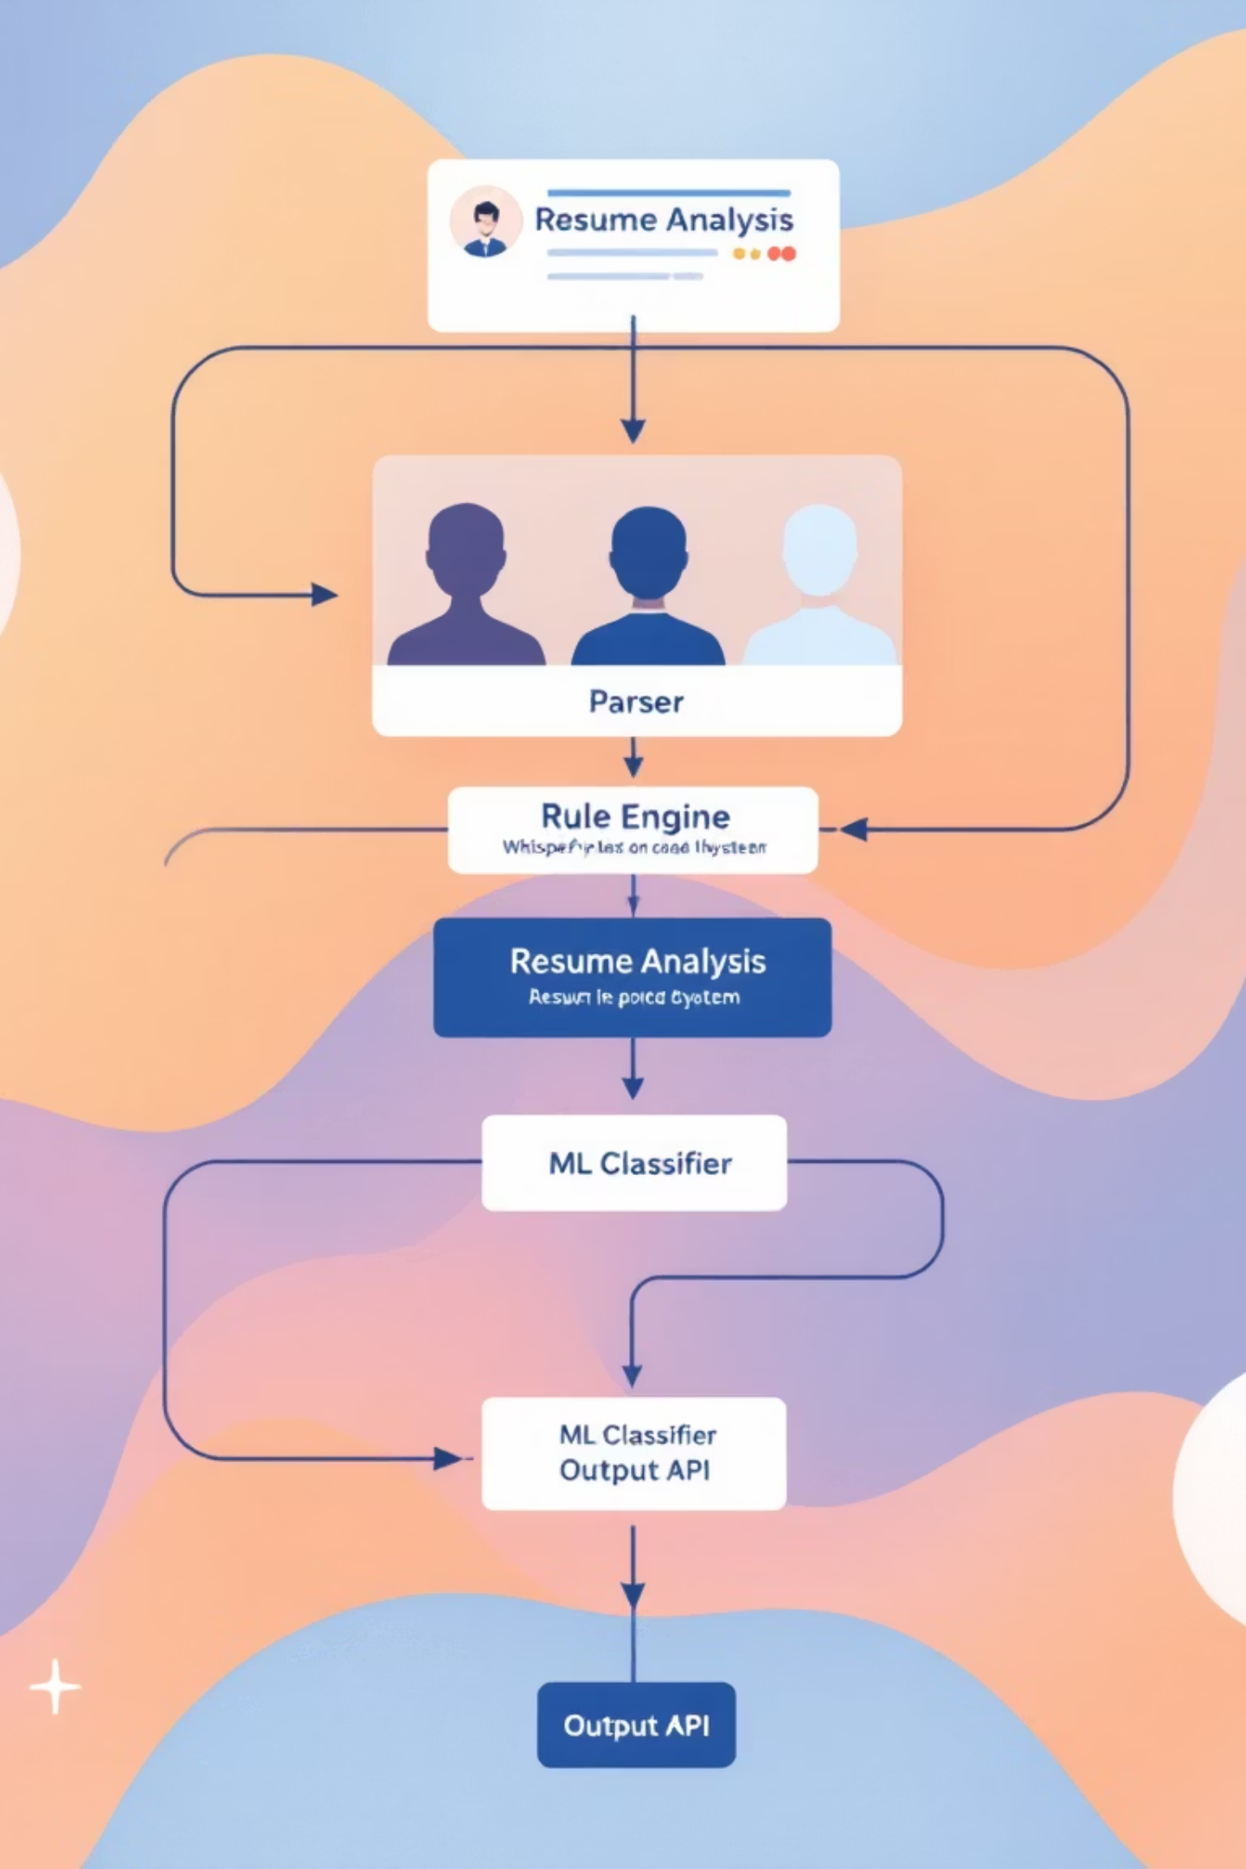

Workflow Overview: From Input to Insight
The system's high-level workflow begins with resume input, which is then parsed and fed into our analysis engine. This engine identifies areas for improvement, generating initial suggestions. These suggestions are then enriched and categorised by the ML classifier before being presented as structured feedback to the user or integrated via API.
This streamlined process ensures efficient and accurate feedback delivery, enabling users to quickly identify and address resume shortcomings.

Slide 9

Dataset Creation: Fueling Intelligent Classification
A high-quality dataset is paramount for robust ML classification. We meticulously crafted a unique dataset featuring:
10,000+ Paraphrased Suggestions: Diverse phrasing to capture linguistic variations.
Noise Augmentation: Introducing controlled "noise" to enhance model robustness against real-world imperfections.
Hard Negatives: Carefully selected examples to challenge the model and refine its decision boundaries.
Balanced Categories: Ensuring equitable representation across all suggestion labels to prevent bias.
Train-Test Split: A standard 80/20 split was used for model training and unbiased performance evaluation.
This comprehensive approach to dataset creation is key to the accuracy and reliability of our multi-label classification system.

Slide 10

Machine Learning Model: Precision in Classification
TF-IDF Vectorizer
Logistic Regression (One-vs-Rest)
Transforms text data into numerical feature vectors, capturing word importance within and across suggestions.
A robust linear model chosen for its interpretability and effectiveness in handling multi-label classification by training a binary classifier for each label.
MultiLabelBinarizer
Converts multi-label targets into a binary indicator matrix, a format suitable for multi-label classification algorithms.
The model achieved high accuracy and strong F1-scores across all categories, demonstrating its capability to accurately classify a wide range of resume suggestions effectively.

